Slide 1
Group 3
Read the information from the ‘Sugarbag’ website and write down 5 interesting facts
http://www.sugarbag.net/
What colour is Europe on the map? Draw arrows from the bees to native continent.
Notes:
Provide as much scaffolding as necessary. You could even highlight or circle the relevant sentences and photos or get the students to do that and read and unpack them together. You could record yourself reading the questions so that the students can hear the questions while you are supporting other groups.

Slide 2
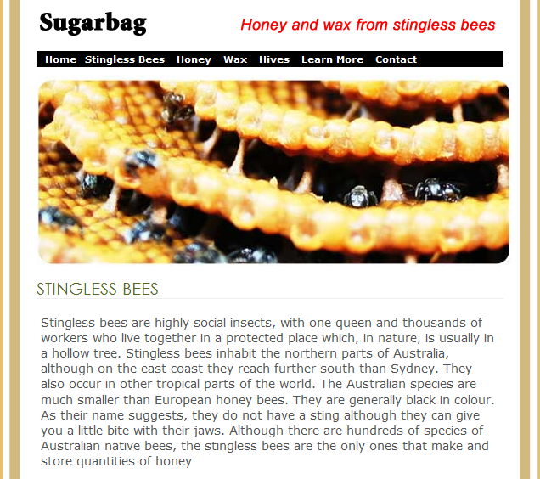
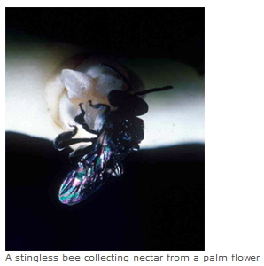

Slide 3
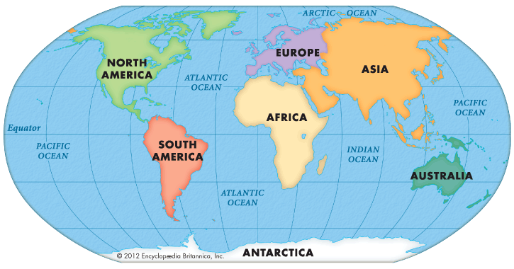
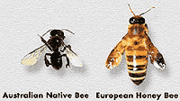

Slide 4
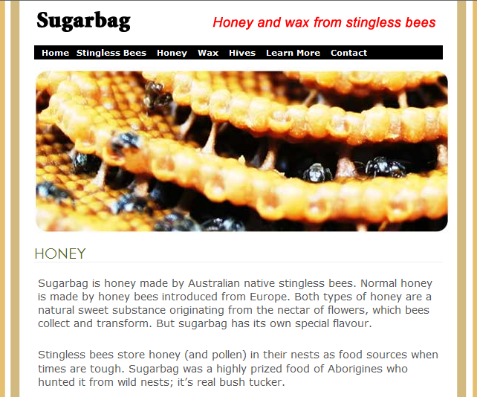

Slide 5
