Slide 1
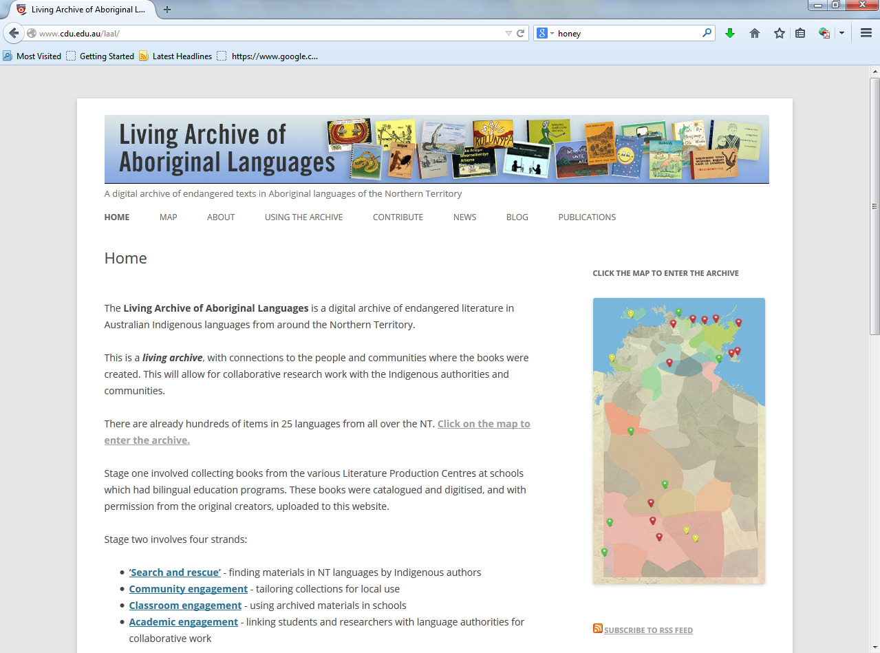
Notes:
Direct students to the Living Archive of Aboriginal Languages website: www.cdu.edu.au/laal
This address will take you to the project page that contains information about the project and it’s partners. Students need to click on the map tab or image to enter the archive.

Slide 2
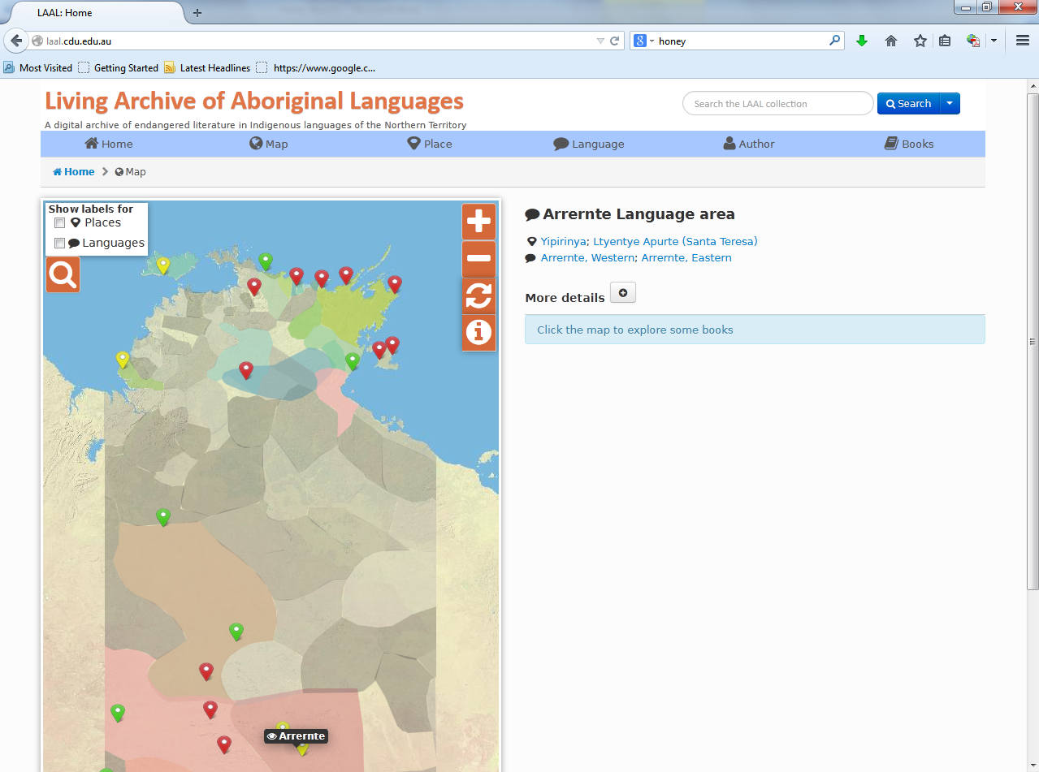
Notes:
Students may need to be prompted to use the LAAL search box rather than the web browser’s search engine.

